Slide 1
You Only Cache Once:
Decoder-Decoder Architectures for Language Models
Yutao Sun, Li Dong, Yi Zhu, Shaohan Huang, Wenhui Wang, Shuming Ma, Quanlu Zhang, Jianyong Wang, Furu Wei
Bug Killers
Apr 29, 2025

Slide 2
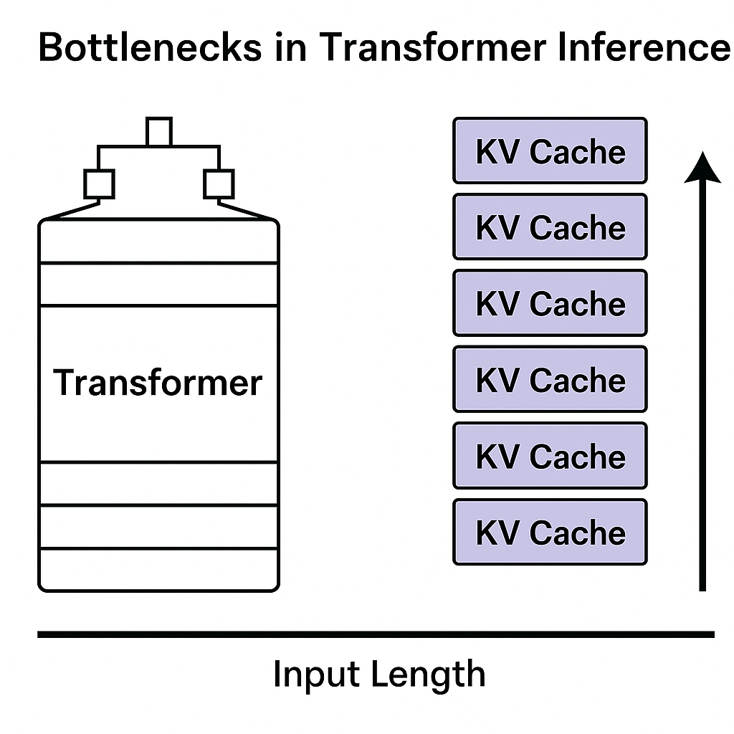
Background
Bottlenecks in Transformer Inference
Transformer is the mainstream architecture for large language models (LLMs).
Efficient inference relies heavily on Key-Value (KV) Caching.
Major Problems:
Memory explosion: KV Cache grows linearly with input length.
High prefill latency: Processing long input sequences becomes very slow.

Slide 3
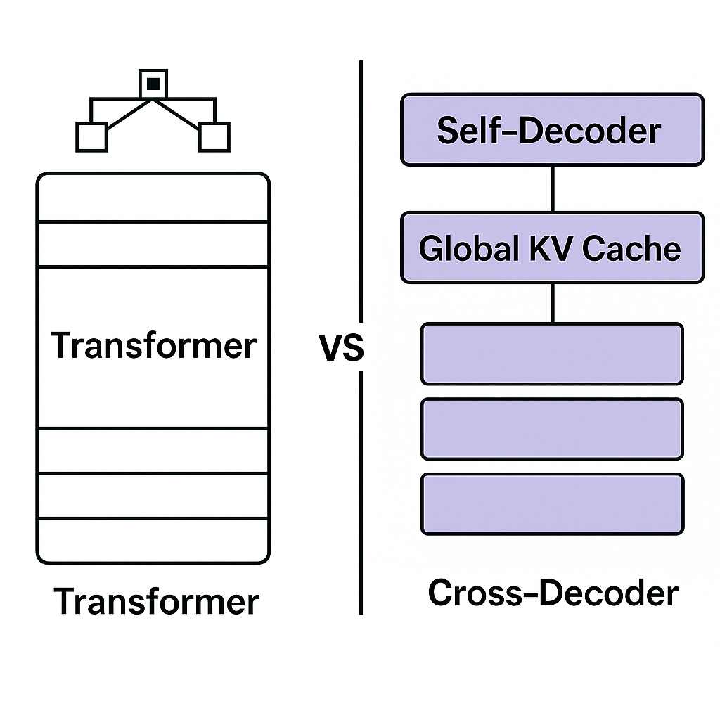
Motivation
You Only Cache Once
How can we reduce KV Cache memory usage?
How can we speed up the prefill stage?
YOCO proposes a novel approach:
Decoder-Decoder Architecture.
Global KV cache generated only once and reused across layers.

Slide 4
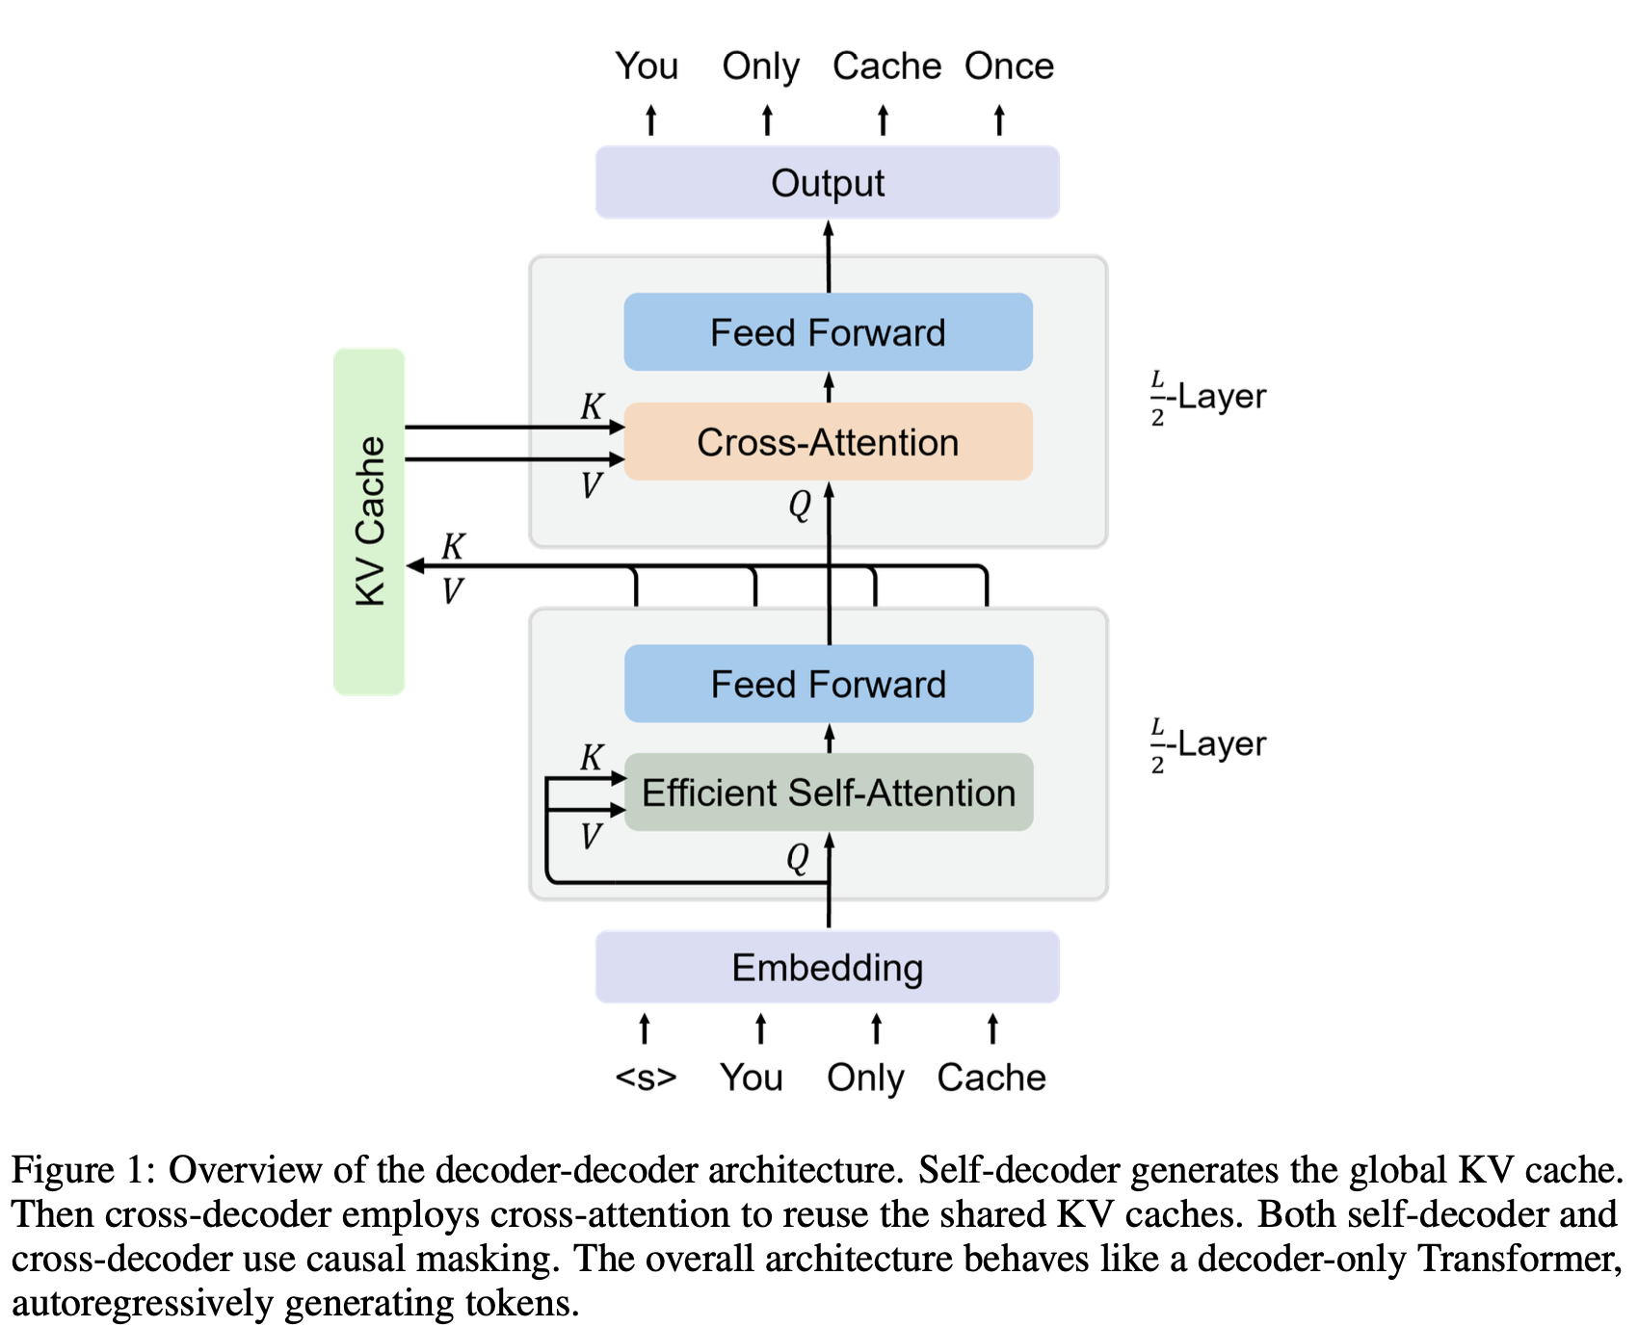
YOCO Overall Architecture
Two main components:
Self-Decoder: Encodes input and generates global KV cache.
Cross-Decoder: Reuses the global KV cache via Cross-Attention.
Externally behaves like a Decoder-only Transformer.

Slide 5
Self-Decoder Details
Aspect | Vanilla Attention | Efficient Self-Attention (Sliding Window / Gated Retention)
Memory Growth (Inference) | O(N × L × D) | O(C × L × D) or constant (C ≪ N)
Computation Complexity | O(N² × D) | O(N × C × D) or O(N × D)
Attention Scope | Full sequence | Limited window / local + global structure
KV Cache Size | Grows linearly with sequence | Constant or window-bounded
Long-Context Capability | Difficult due to memory limits | Enables longer context modeling efficiently
Example Techniques | Standard Multi-Head Attention | Sliding-Window Attention, Gated Retention (gRetNet)
Employs efficient self-attention mechanisms:
Sliding-Window Attention.
Gated Retention.
Achieves O(1) inference memory, independent of input length.
Responsible for producing the global KV cache.

Slide 6
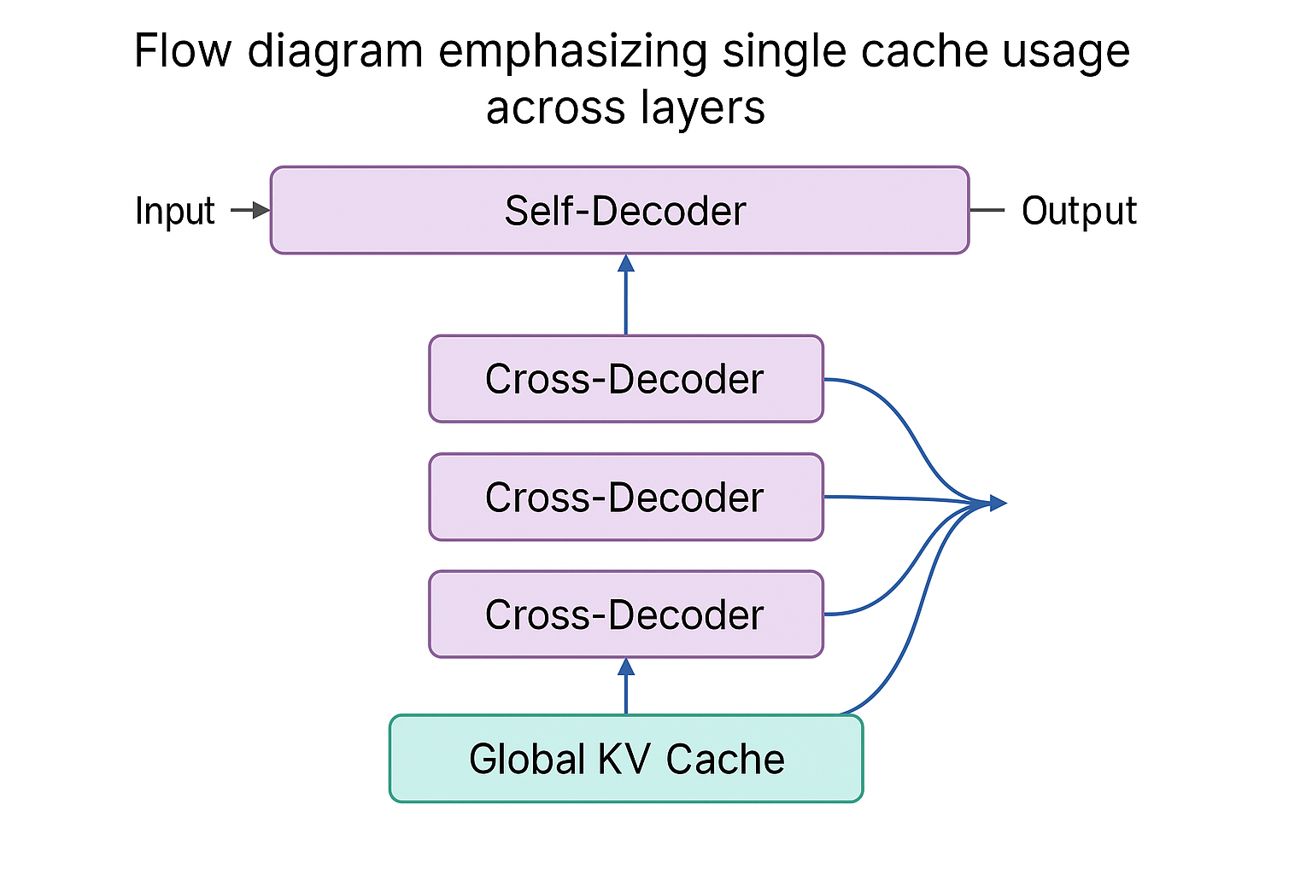
Cross-Decoder Details
After obtaining KV caches from Self-Decoder:
All Cross-Decoder layers reuse the global KV cache via Cross-Attention.
Causal masking is still applied for autoregressive generation.

Slide 7
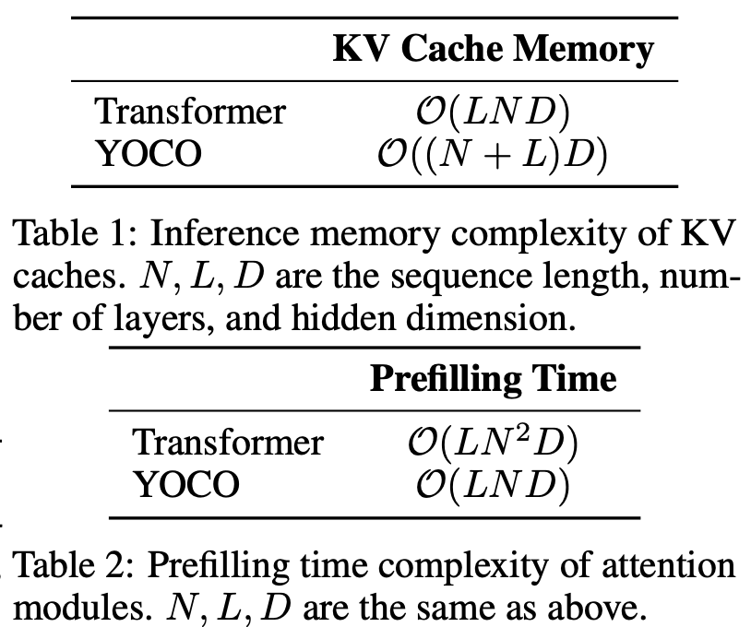
Key Inference Advantages of YOCO
Significant GPU memory reduction (up to ~80x smaller KV Cache).
Accelerated prefill stage (linear rather than quadratic time complexity).
Improved throughput with larger batch sizes.

Slide 8
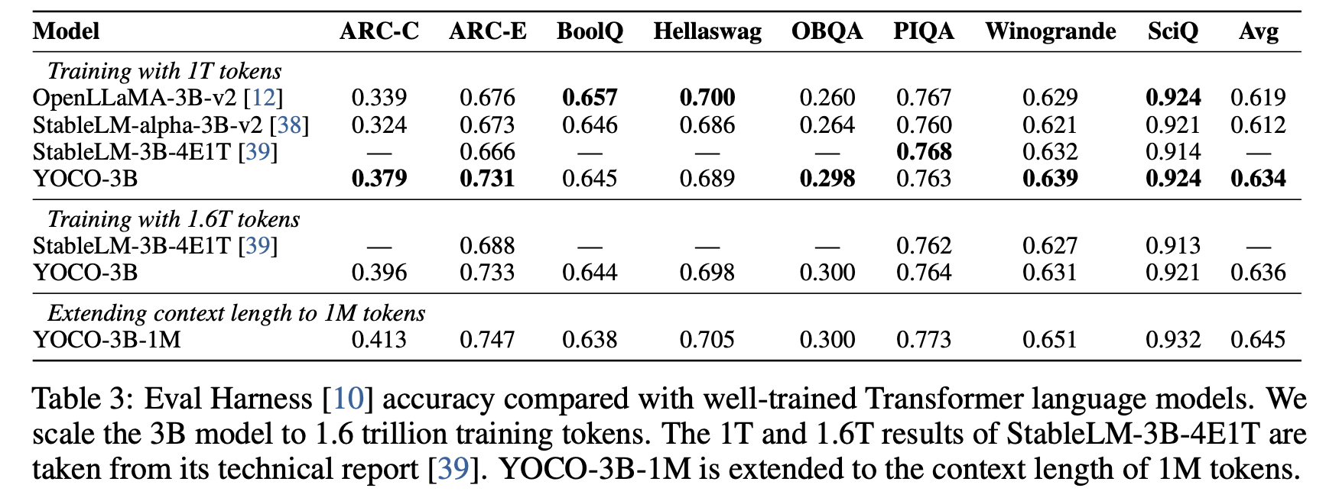
YOCO Performance on Language Modeling
Compared with StableLM, OpenLLaMA, and other strong baselines.
3B YOCO model matches or exceeds Transformer baselines after training on 1T and 1.6T tokens.

Slide 9
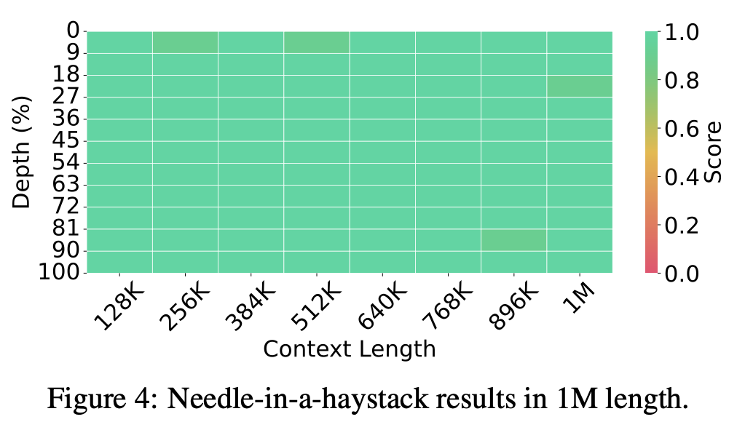
Extending Context Length to 1M Tokens
YOCO scales up to 1M token context length.
Achieves near-perfect retrieval accuracy in Needle-in-a-Haystack tests.

Slide 10
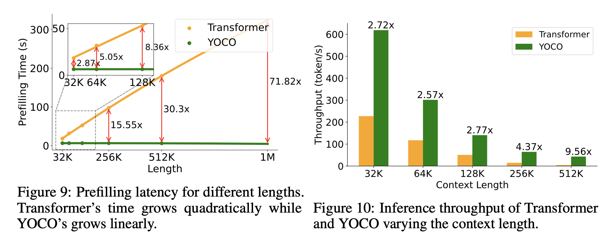
Prefill Speedup and Throughput Improvement
Prefilling 512K tokens:
Transformer: 180 seconds
YOCO: less than 6 seconds
Throughput for 512K context:
9.6x higher than Transformer.

Slide 11
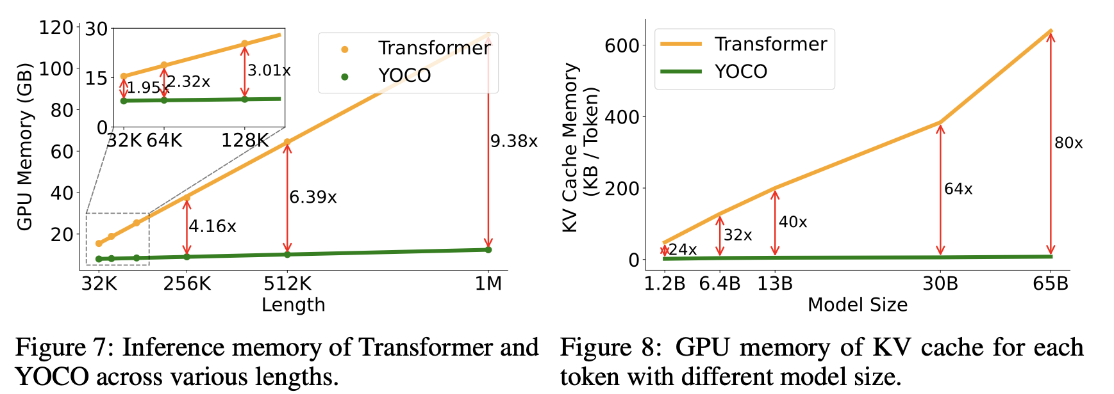
Significant GPU Memory Reduction
For 1M tokens:
Transformer uses 86GB memory.
YOCO only needs 12.4GB.
Enables long-context LLMs to run even on consumer-grade GPUs.

Slide 12
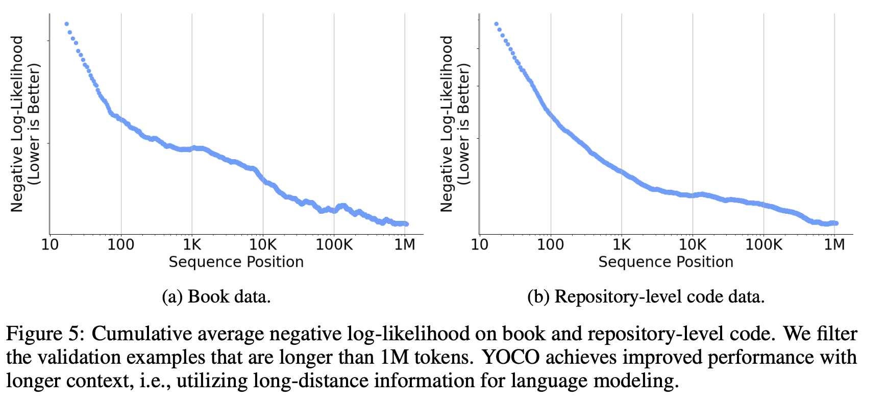
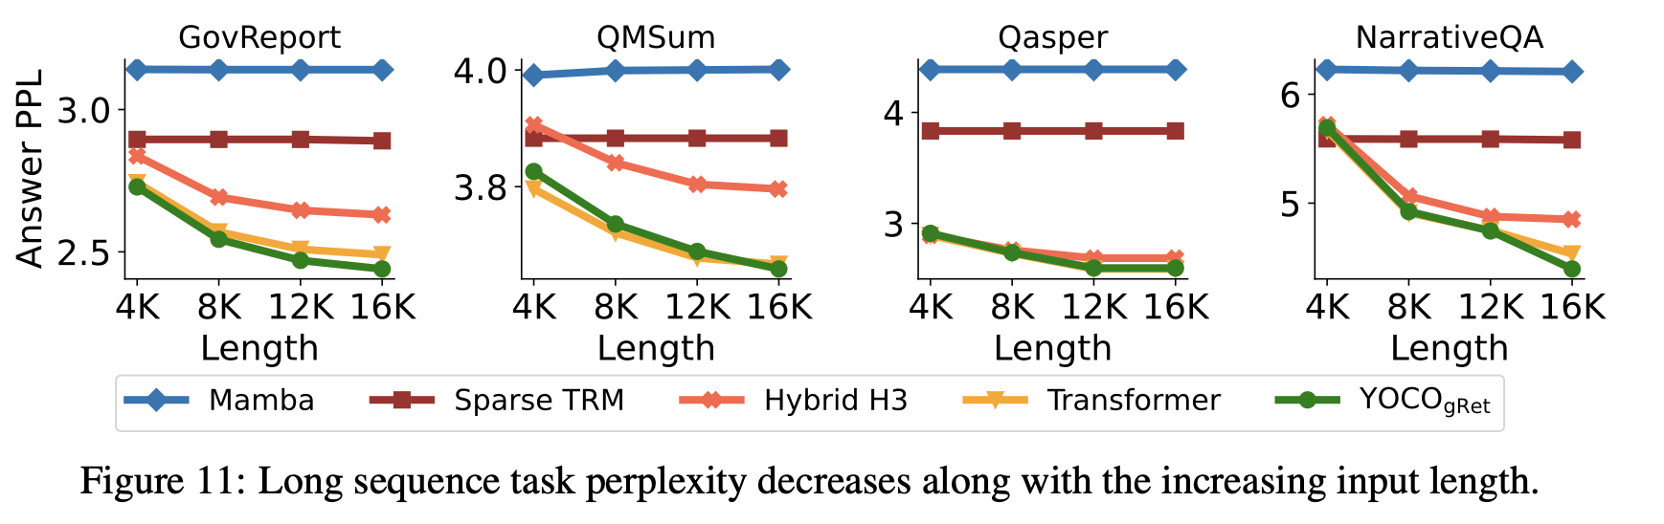
Comparison Against Mamba, RetNet, and Others
YOCO and Transformer outperform alternatives like Mamba, RetNet, Hybrid H3 on ZeroSCROLLS tasks.
YOCO retains global attention capabilities.

Slide 13
Conclusion & Future Work
YOCO introduces a new efficient inference architecture for long-context language models.
Achieves competitive performance and dramatic inference efficiency gains.
Future Directions:
Further optimize the Self-Decoder design.
Explore dynamic ratios of Self vs Cross Decoder layers.

Slide 14
Cache Once, Serve More.
Thanks for watching!
Bug Killers
Apr 29, 2025

